Slide 1

Group 3 Project Presentation
Joel Felix Quadras (D22125093 - DS) Cheril Mariam John (D22124272 - ASD) Mountdenyraj Chelladurai Nadar (D22124430 - ASD) David Ayang (D21127639 - ASD)

Slide 2
Project Vision
What are you trying to do?
Accessibilator converts various documents (PowerPoint, Word, Excel) into accessible formats. We use fonts, colors, and machine learning (image labeling, text summarization) for better accessibility.
Who are you doing this for?
Our main audience comprises individuals with various accessibility needs, including dyslexia, dyscalculia, language disorders, and physical disabilities like color blindness and visual impairment. This also extends to caregivers, therapists, and special educators who support them.
Secondary users encompass educational institutions, healthcare providers, and government agencies seeking accessible documents to meet compliance and promote inclusivity
Why do they need it?
Common document formats often lack accessibility design, making them challenging for many users..
Enhancing accessibility levels the playing field, ensuring everyone can access and utilize the information provided.
Meeting accessibility standards can be challenging for organizations, leading to legal risks and excluding sections of people in the society.

Slide 3
Technology Stack
Front-end Technologies
Framework: Next.js
Styling UI Library Component Library: Tailwind CSS/Headless UI/Mantine
Testing: Jest/React Testing Library, Cypress
Back-end Technologies
Cloud Hosting and Management: AWS Amplify
Serverless Functions: AWS Lambda with Express.js
API Gateway: AWS API Gateway
Workflow Management: AWS Step Functions
Database/File Storage: Amazon DynamoDB and Amazon S3
Machine Learning
Framework: Tensorflow
ML Hosting Platform: Amazon SageMaker
DevOps
Version Control: Git/GitHub
Team Communication/File Sharing: Slack Workspace
Project Management: Azure DevOps
CI/CD: GitHub Actions
Monitoring and Logging: Sentry
Data Sources
Document Data: User uploads
User Preferences and History: Stored in DynamoDB
Textual data from WikiLarge, Optus, Google Dataset and News Articles
Labelled Image dataset from Google Dataset and Kaggle
Accessibility Templates: Predefined and stored in Amazon S3

Slide 4
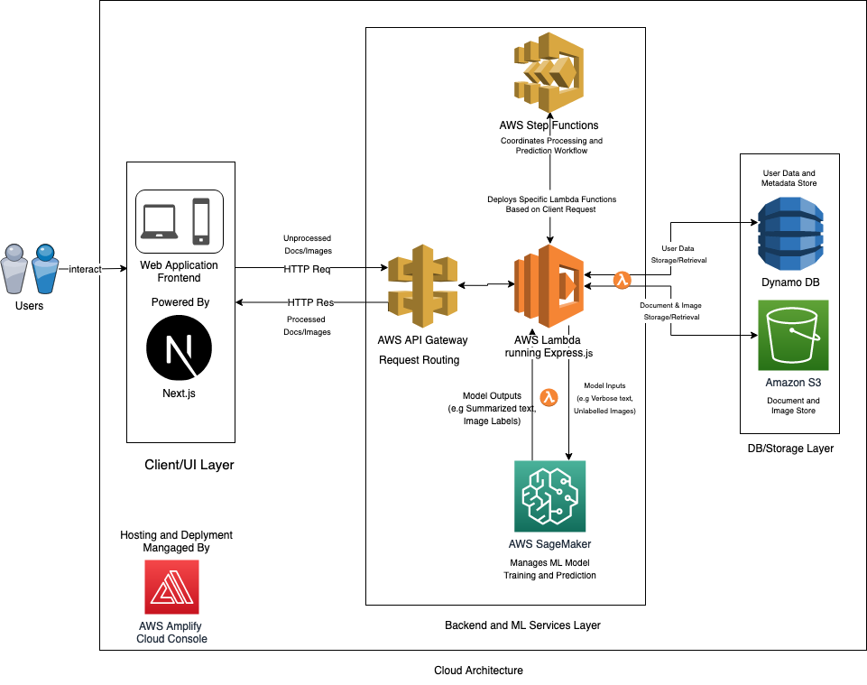
Technical Architecture
Front-end/UI Layer
Utilizing Next.js, leveraging advanced features like server-side rendering and SEO optimization for better performance and discoverability.
UI Components
Accessibility Format Selector: Dropdown menu or button grid for selecting predefined accessibility formats.
Document Upload Interface: Drag-and-drop area with file type icons for supported formats.
Document Review Interface: Interactive preview pane with zoom and page navigation features.
Customization Panel: Sidebar or modal with sliders and checkboxes for fine-tuning settings.
User Dashboard: Sections for profile information and document history.
Feedback Form: Widget for user feedback on optimization and output.

Slide 5
Technical Architecture
Back-end and ML Layer
AWS Amplify: Integrated development platform for streamlining both front-end and back-end services, including managed cloud hosting and deployment.
AWS Services
AWS Lambda with Express.js: Serverless architecture for handling RESTful API requests.
AWS API Gateway: Entry point for API requests, with features like rate limiting and caching.
Amazon S3: Temporary storage for uploaded and processed documents.
Amazon SageMaker: Complete ML development tools for text summarization, color correction, and font adjustments.
AWS Step Functions: Workflow coordination for document processing.
Amazon DynamoDB: Storage for user-specific data like preferences, history, and annotations.

Slide 6
Minimum Viable Product (MVP)
First MVP: Core functionality development for Accessibilator.
Users can upload Word documents and apply predefined dyslexic-friendly accessibility templates.
Customization options for font styles, sizes, and color corrections.
Initial version includes machine learning enhancements to convert complicated text to simplified content.
Following Feature-Driven Development approach for structured and iterative development.
Features divided into manageable components, developed and integrated incrementally.

Slide 7
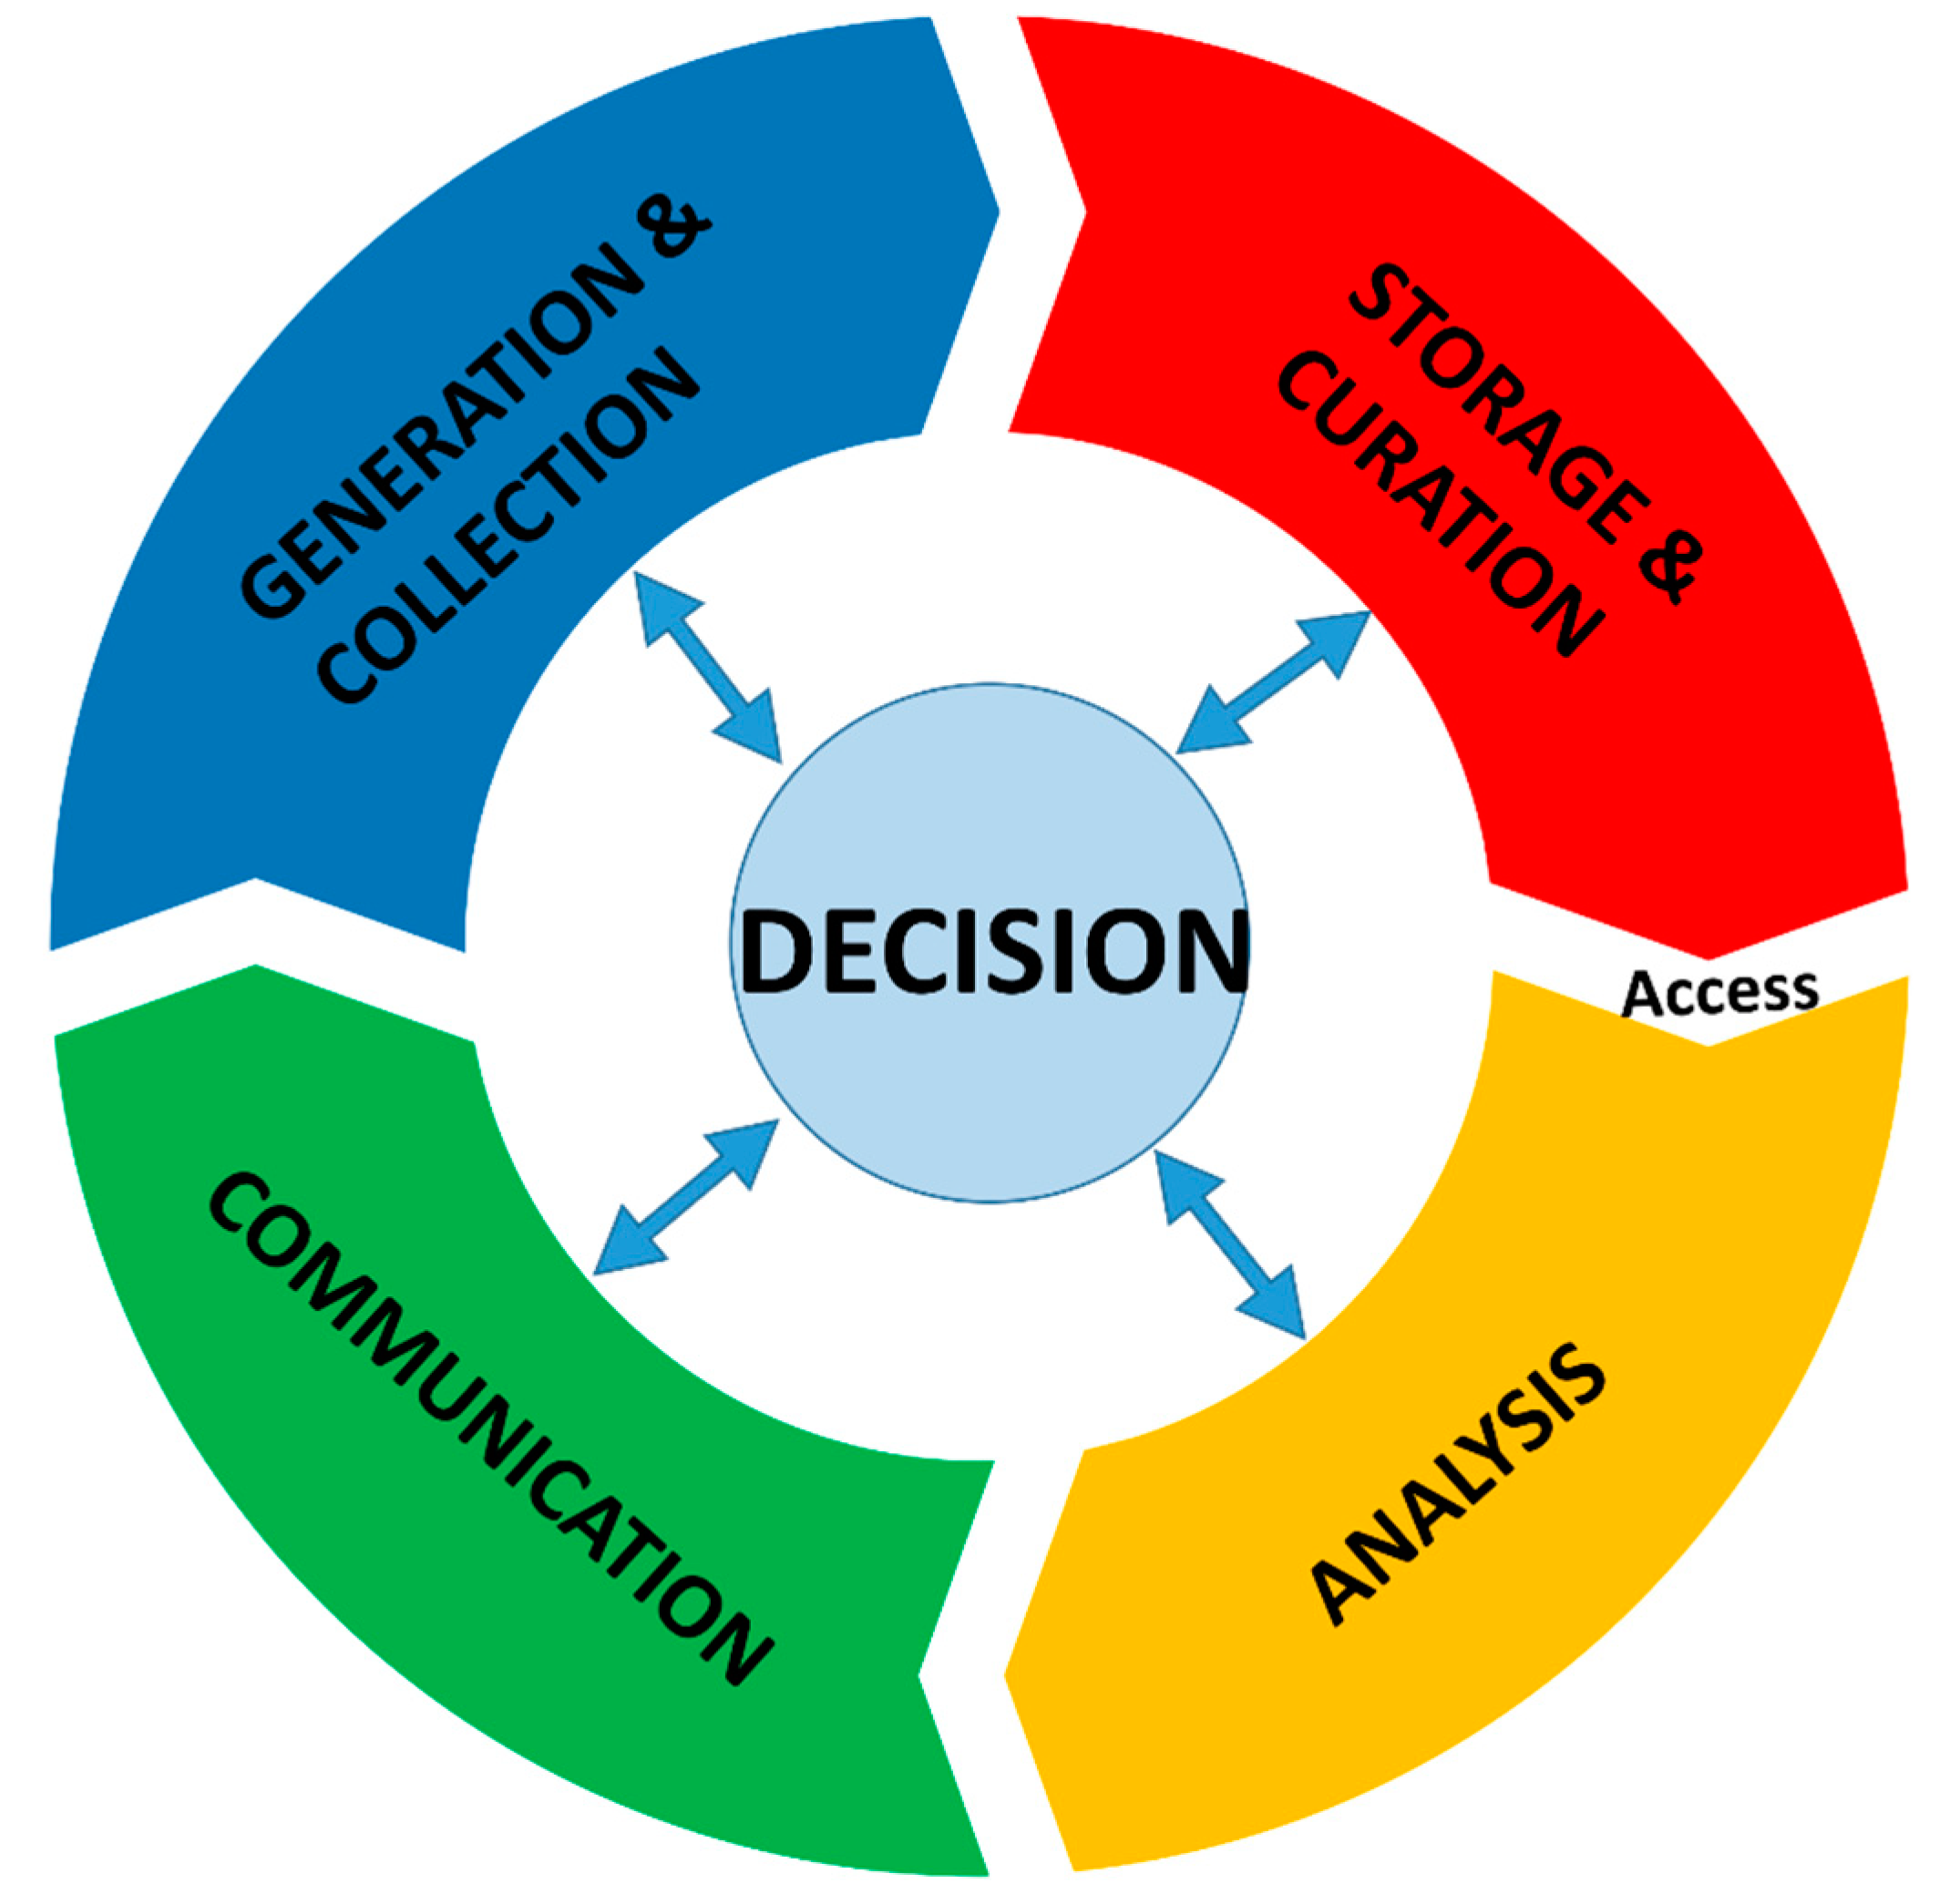
Data Stack
What are the key data resources you are using and how are you collecting, storing and accessing them?
Data Collection : The data collected can be divided into 2 parts.
Application Data
Login Credentials
Documents uploaded by the user.
Machine Learning Data
Data containing complex text and simplified text.
Data of label Images
Storage: Data collected will be stored in AWS Dynamo DB and Amazon RDS. Once the user has completed his task all his data will be deleted.
Access: Implementation of strict data measures such as encryption, authentication and authorization, to protect data from unauthorized access or breaches.
Figure 1

Slide 8
User Evaluation planning
To assess the effectiveness, usability, and accessibility of Accessibilator across diverse user groups. We aim to employ the following methods:
Usability Testing: Conduct one-on-one sessions with users to evaluate the ease of use and identify any UI/UX issues.
Feedback Surveys: Post-interaction surveys to gauge user satisfaction and collect suggestions for improvements.
Accessibility Metrics: Utilize automated testing tools to measure compliance with established accessibility standards like WCAG.
Comparative Analysis: Record the time taken for users to read through documents before and after customization to quantify improvements in accessibility.
A/B Testing: Experiment with different features and UI elements to determine which configurations yield the best user experience.
We'll evaluate our machine learning model using a range of metrics, including accuracy, error rate, F1 score, precision, recall, confusion matrix, mean absolute error (MAE), mean squared error (MSE), root mean squared error (RMSE), R-squared, area under the ROC curve (AUC-ROC), and hinge loss. Our metric selection will be guided by a thorough analysis of the project's specific requirements for a comprehensive evaluation.

Slide 9
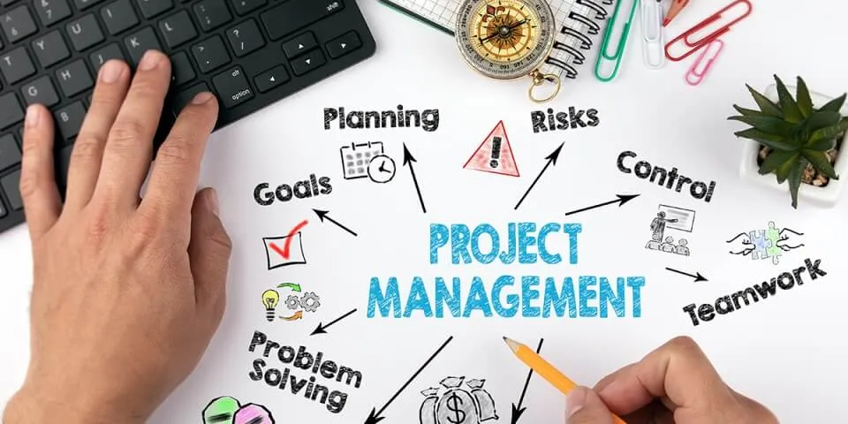
Project Management.
SCRUM Methodology for Project Development
Daily Stand-Up at 10 pm Monday to Friday. (What did I do ? What I am doing ? Any Challenges.)
Sprint Planning Ceremony Once every two weeks for feature discussion, User story selection. Every sprint the role of scrum master and product owner will be rotated between the team members.
Sprint Review and Retrospective.
Azure Boards for Project Mangement as it can integrated with GitHub and Slack.
Slack for team communication.
GitHub for source code repository.

Slide 10

Team Meetings and Conflict Mangement.
Online team meetings: Monday to Friday, 10 pm.
In-person meetings at university: After online session, 12 pm to 2 pm. (Feedback discussion and planning for the next week)
Online meetings initially 1 hour, transitioning to 20 min standup once tasks are defined.
Fostering collaboration and task ownership.
Resolving issues internally among team members.
Non-judgmental and constructive discussion for conflict resolution.
Emphasis on clear and open communication to prevent conflicts.
Delegating final decisions to the team member with the most expertise in the area.

Slide 11
Conclusion
Accessibilator, is designed with a user-centric approach to meet the diverse needs of our target audience, especially those with accessibility challenges. We are committed to an iterative development process, where the feedback and metrics collected during the user evaluation phase will be instrumental in shaping future development cycles. This allows us to make data-driven decisions and prioritize features that will have the most impact on user experience.
Moreover, we are committed to adhering to established accessibility standards like WCAG, ensuring that our product is not just functional but also inclusive. Our technology stack, which includes Next.js for the front-end, AWS Lambda for serverless computing, and Amazon SageMaker for machine learning capabilities, has been carefully selected to provide a scalable and robust architecture. This ensures that our system can easily adapt to future enhancements and user needs.

